Slide 1

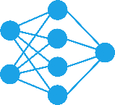
Description of Course
Hamidreza Baradaran Kashani
Neural Networks Course (Fall 2022)
1

Slide 2
Learning Objective
Upon completion of this course, the students will be able to:
understand important concepts and theories of artificial neural networks (ANNs) and deep neural networks (DNNs).
understand how ANNs and DNNs can be designed and trained.
understand how ANNs and DNNs can be applied for different machine learning-based applications and used to solve real-world problems.
2

Slide 3
Prerequisites & Grading
Prerequisites
Basics of probability theory, linear algebra and calculus at university level.
Programming skills (Python will be used throughout the course).
Grading
Mandatory Assignment
Final Project
Final Exam
Active Participation
3

Slide 4
Outline
Part I: Artificial Neural Networks
Introduction
Neuron Model
Perceptron
Linear Algebra
Optimization
Backpropagation
Generalization
4

Slide 5
Outline
Part 2: Basic Concepts of Deep Learning
Feed-Forward Neural Networks
Convolution Neural Networks
Recurrent Neural Networks
Attention Mechanisms
Transformers
Generative Adversarial Networks
5

Slide 6

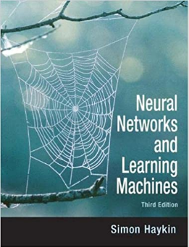
References
Martin Hagan et al. Neural Network Design, 2nd Edition. 2014 (hagan.okstate.edu/nnd.html)
S. O. Haykin, Neural Networks and Learning Machines, 3rd Edition, Prentice Hall, 2008.
6

Slide 7
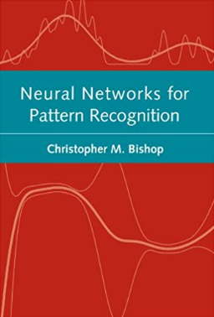

References
Bishop, Christopher M. Neural networks for pattern recognition. Oxford university press, 1995.
Goodfellow, Ian, Yoshua Bengio, and Aaron Courville. Deep learning. MIT press, 2016.
Some papers in the field of Deep Learning.
7

Slide 8
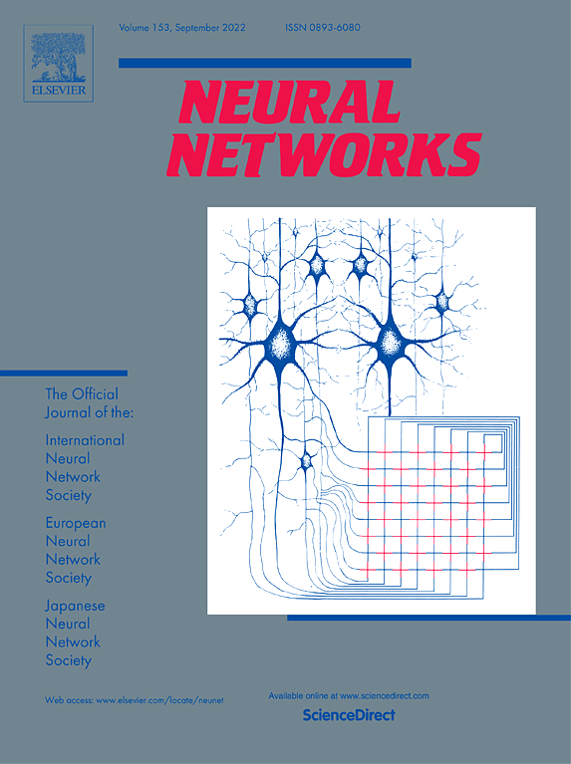
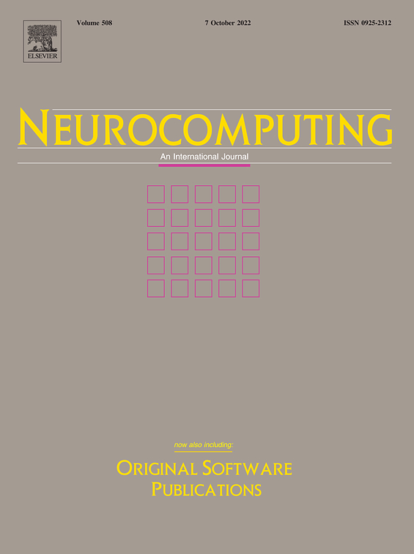
Journals for NN
IEEE Transactions on Neural Networks and Learning Systems
Neural Networks (Elsevier)
Neural Computation (MIT)
Neurocomputing (Elsevier)
Neural Processing Letters (Springer)
Neural Computing and Applications (Springer)
International Journal of Neural Systems (World Scientific)
8

Slide 9
Conferences for NN
NeurIPS (Neural Information Processing Systems)
ICLR (International Conference on Learning Representations)
CVPR (Computer Vision and Pattern Recognition)
AAAI (Conference on Artificial Intelligence)
ICML (International Conference on Machine Learning)
IJCNN (International Joint Conference on Neural Networks)
ICANN (International Conference on Artificial Neural Networks)
9

Slide 10
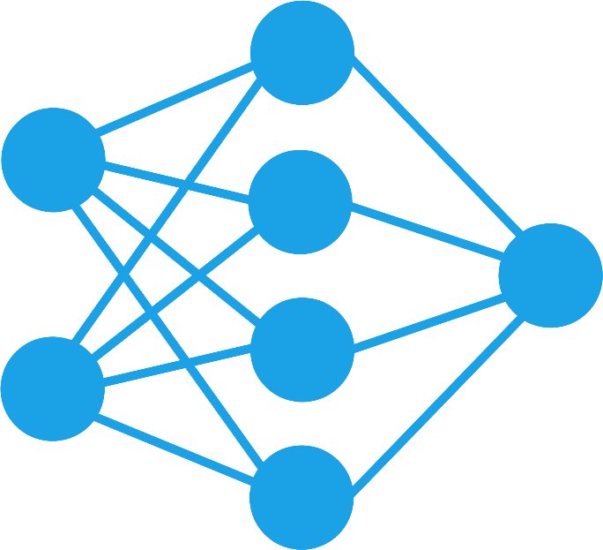
Thanks for your attention
Hamidreza Baradaran Kashani
10

